Slide 1
Bike Sharing Project

Slide 2
Content
01
Data Preprocessing & Cleaning
02
Data Analysis
03
Machine Learning
04 Model Comparison

Slide 3



Data Preprocessing & Cleaning
Check for null values Check for duplicate
Remove the outliers

Slide 4
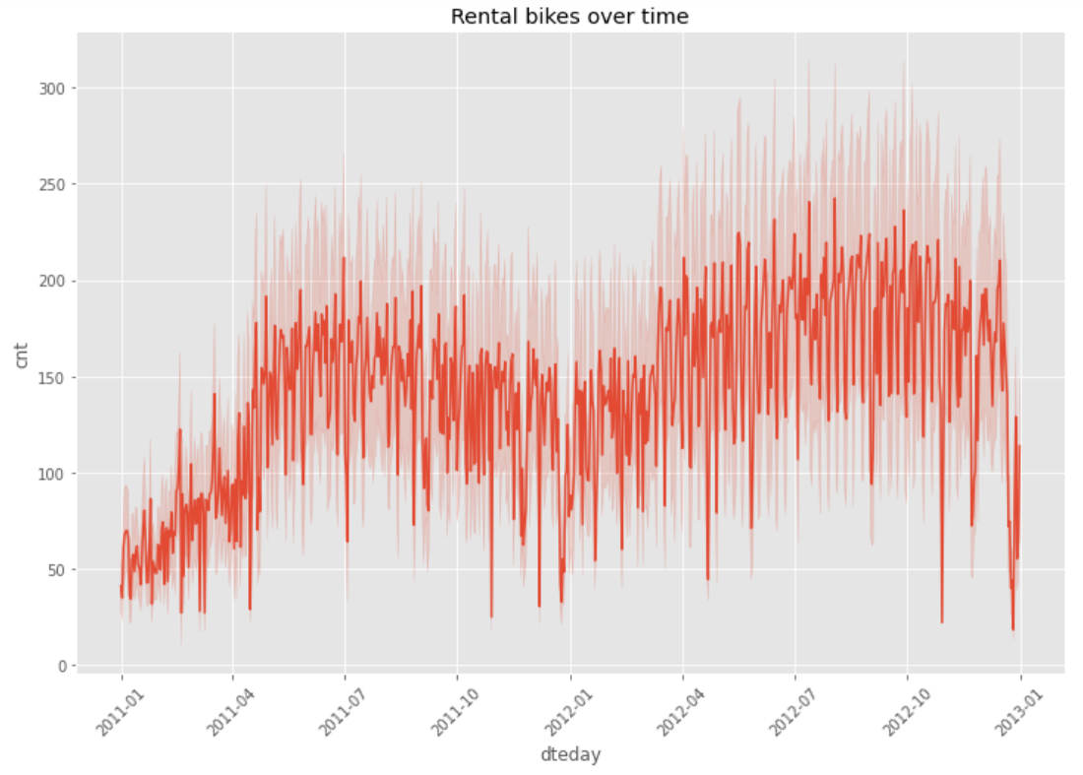
Data Analysis and Visualization

Slide 5
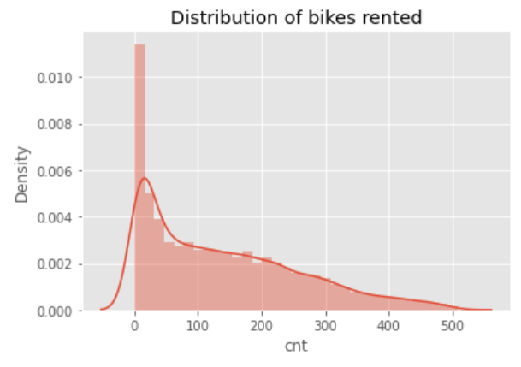

Slide 6
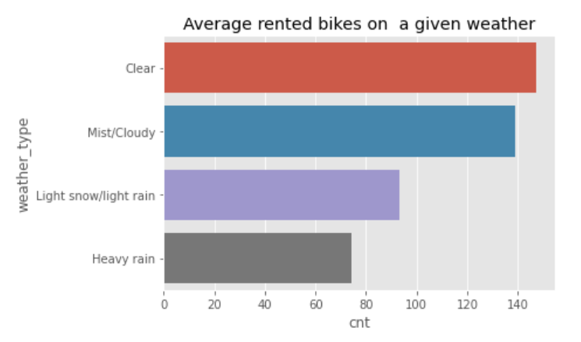

Slide 7
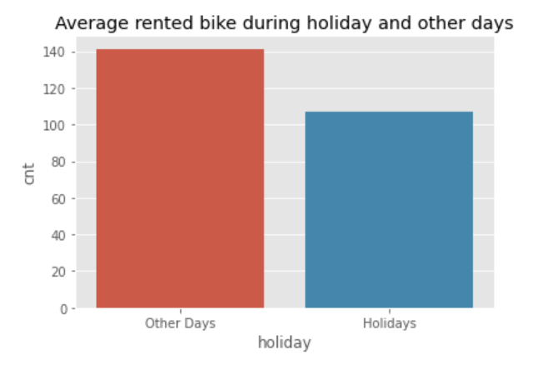

Slide 8
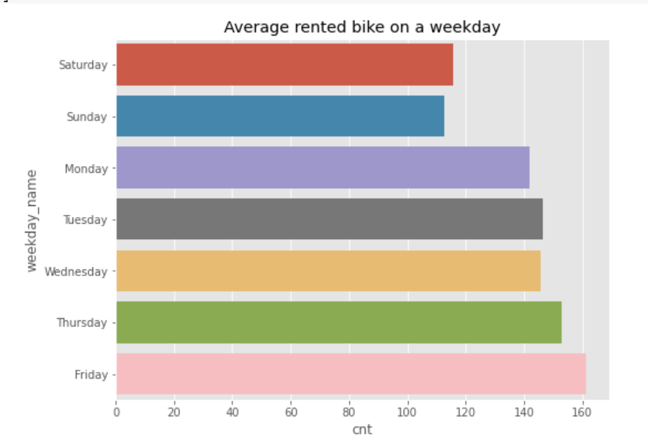

Slide 9
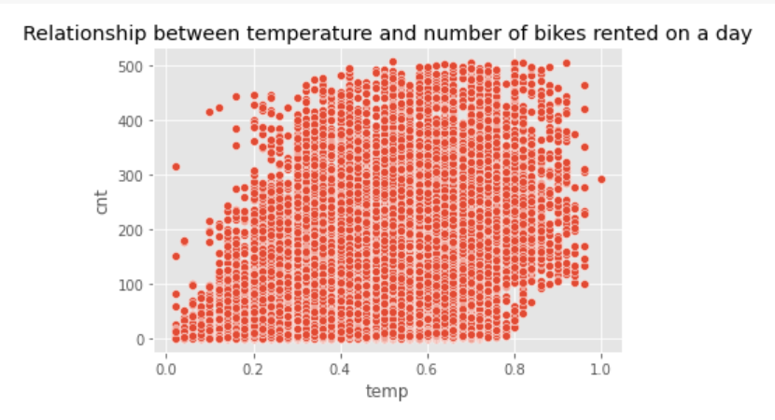

Slide 10
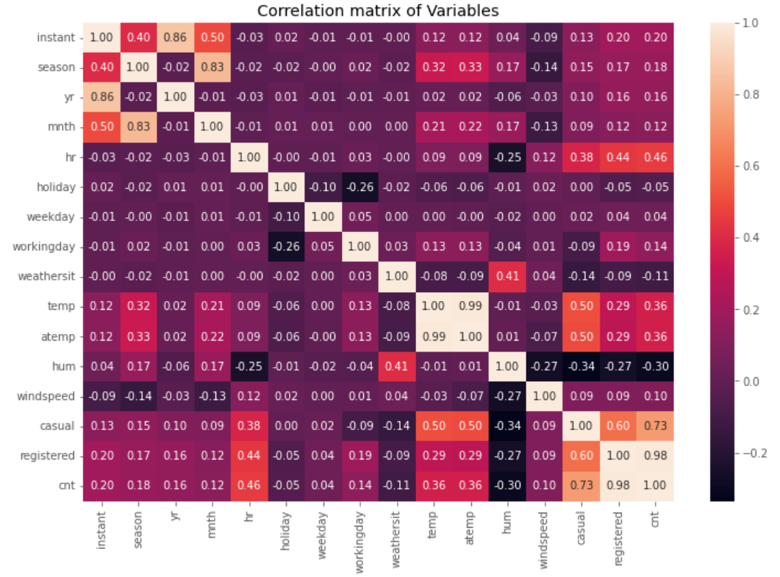

Slide 11
Machine Learning
Models Used
LINEAR REGRESSION
RIDGE REGRESSION
RANDOM FOREST REGRESSOR
GRADIENT BOOSTING REGRESSION
LASSO REGRESSION

Slide 12
Machine Learning
EVLUATION METRICS
ROOT MEAN SQUARED ERROR (RMSE)
MEAN SQUARED ERROR
R2 SCORE

Slide 13
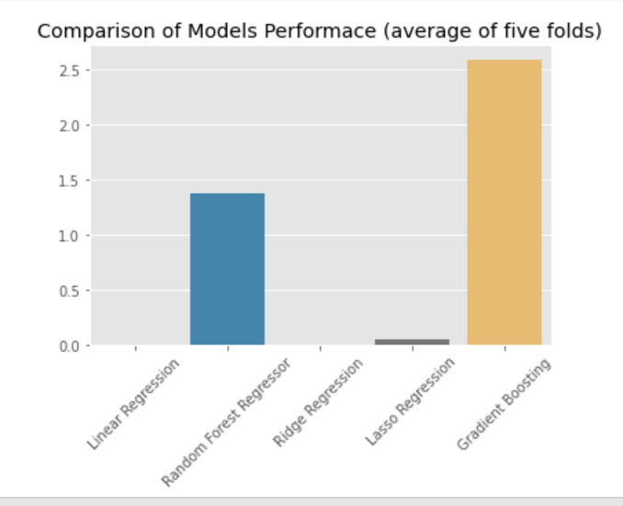

Slide 14
Thank You!

